Slide 1

REMOTE EXAMINATION CONDUCTION ENGINE
Summer Internship Project
GROUP 10

Slide 2
SAURAV SINGH
01
SHAKTI MOURYA
02
SHIVAM SHARMA
03
MEMBERS OF THE TEAM
05
SHIVANGI VERMA
06
SHREYASI GOUR
07
SHUBH KHATRI
Front-End
Designing the Question Pallette
Compiled initial list of elements to be included
Documentation
SHIVANI NARWARIYA
04
UNDER THE GUIDANCE OF
MR. MANISH KHULE
Created a Question Bank for the database
Back-End and Documentation
Front-End
08
SNIGDHA PANDIT
Front-End and Documentation

Slide 3
WHAT IS AN ONLINE EXAMINATION SYSTEM?
An online examination system is a computer-based test system that can be used to conduct computer based tests online. This examination system uses fewer resources and reduces the need for question papers and answer scripts, exam room scheduling, arranging invigilators, coordinating with examiners, and more.

Slide 4
WHY DO WE NEED ONLINE EXAMINATION ENGINES?
• In comparison to the present system the proposed system will be less time consuming and more efficient.
• Results will be very precise and accurate and will be declared in a very short span of time because the calculation and evaluation will be done by the simulator itself.
• The proposed system is very secure as no chances of leakage of question paper as it depends completely on the administrator only.
• The logs of appeared candidates and their marks are stored and can be used for future use.

Slide 5
SCOPE OF THE PROJECT
Compared to other manually taking exams the scope of this project is very vast.
This can be used in educational institutions as well as in corporate world.
Can be used anywhere at any time as it is a web based application (User Location doesn’t matter).
No restriction that examiner has to be present when the candidate takes the test.
Design to facilitate Administrator and User.
Online examination is designed for educational institutes like Schools ,colleges and private institutes to conduct logic tests of their students or employees on regular basis

Slide 6
PROJECT OBJECTIVE
Online examination system is a non removable examination pattern of today’s life.
We need more time saving and more accurate examination system as the number of applicants is increasing day by day.
For all IT students and professionals, it is very important to have some basic understanding about the online examination system.

Slide 7
SOFTWARE REQUIREMENT
HARDWARE REQUIRMENT
CLIENT SIDE
SERVER SIDE
• Operating system: Windows XP and others
• Front End: Visual Basic Net Platform 2010
Browser: Internet Explorer and others
• Browser: Any Browser
• Processor :Pentium 2.0 and above.
• RAM: 256 MB Server Side
• Processor :Pentium 2.0 and above
• RAM: 1 GB
• Hard Disk Space: 4 Gb

Slide 8
TECHNOLOGY USED
FONT END
HTML
CSS
JAVA SCRIPT
BACK END
PHP
MY SQL
AJAX
SERVER USED
XAMPP

Slide 9
THE EXAMINATION MODULE
LOGIN
Step 1
1. Examination process
a) Login to the online examination engine.
b) Attend the Test.
c) Submit and receive the Result.
2. The type of questions asked will be Multiple choice questions.
3. The questions will be generated at random.
START EXAMIANTION
Step 2
Step 3
END EXAMINATION
RESULT
Step 4

Slide 10

1. The Login Page:

Slide 11
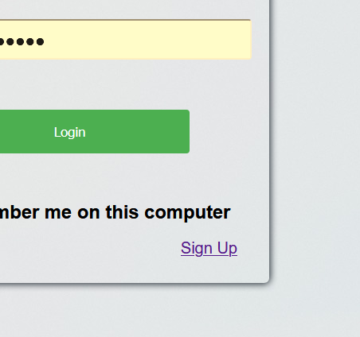


In the Login Page, there are two more options: 1. Sign Up Page: If you haven’t registered earlier then you can register by creating a new account and then you will be able to give the examination.

Slide 12
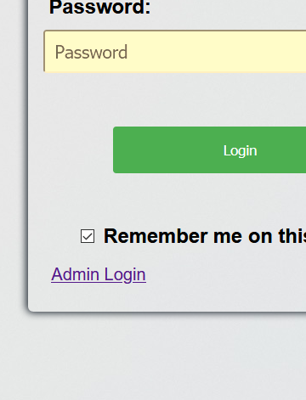

2. Admin Login Page: This login is only for the admins to update or delete the information (or to perform any kind of operation) in the database.

Slide 13
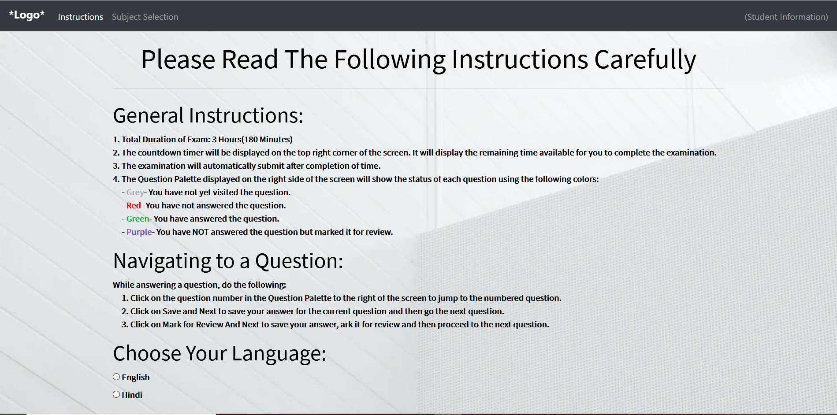
The Instruction Page:
After logging in, the examinee will be directed to the Instruction page where they will be notified about the exam details and will have the option to select the language and subject they want to begin the exam from.

Slide 14
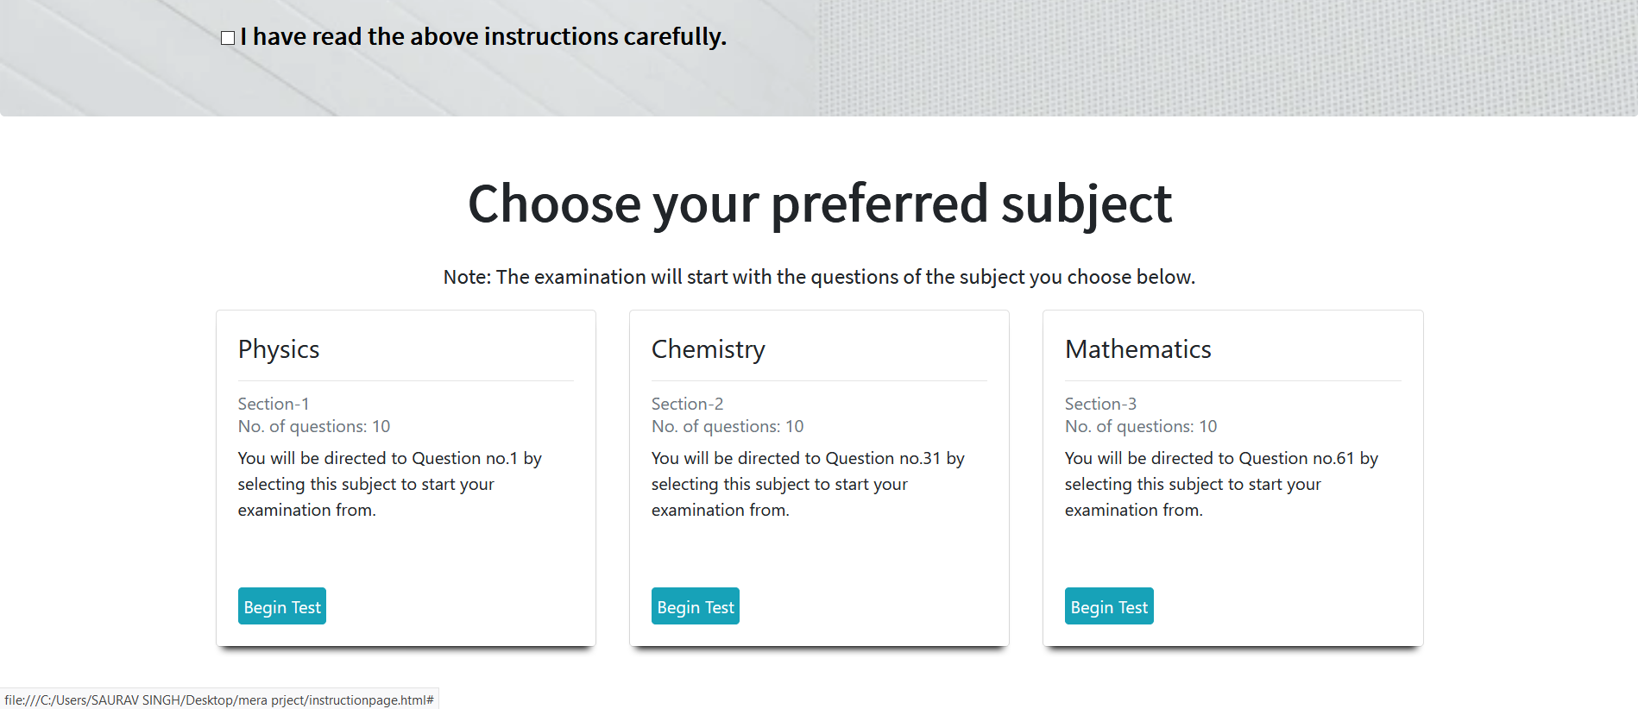

Slide 15
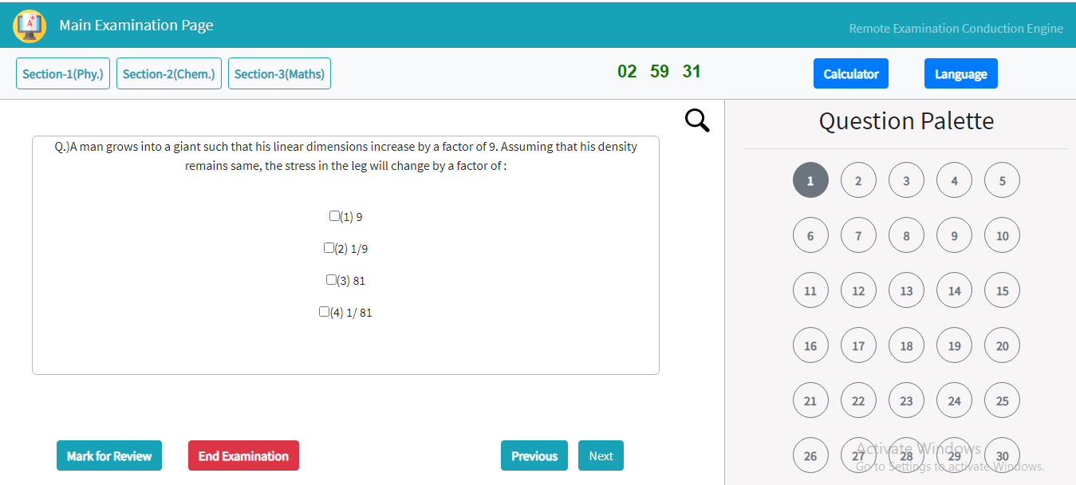
Main Examination Page:

Slide 16
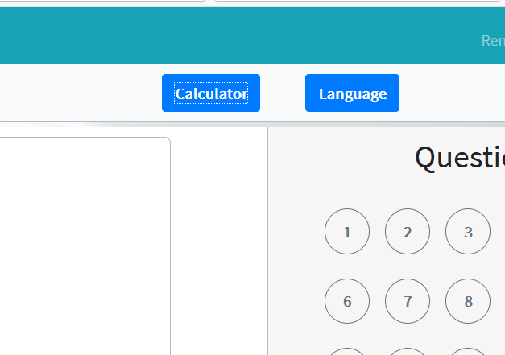
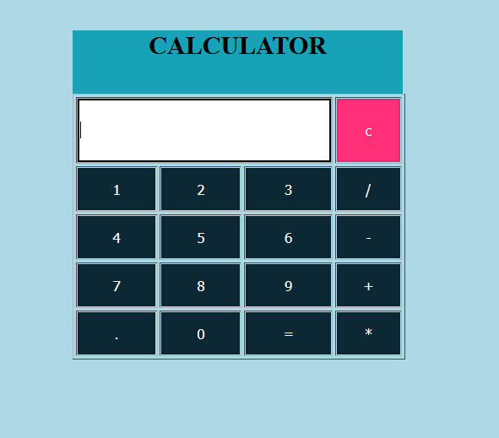
On the main page, the student also has the option of calculator to perform some mathematical calculations.

Slide 17
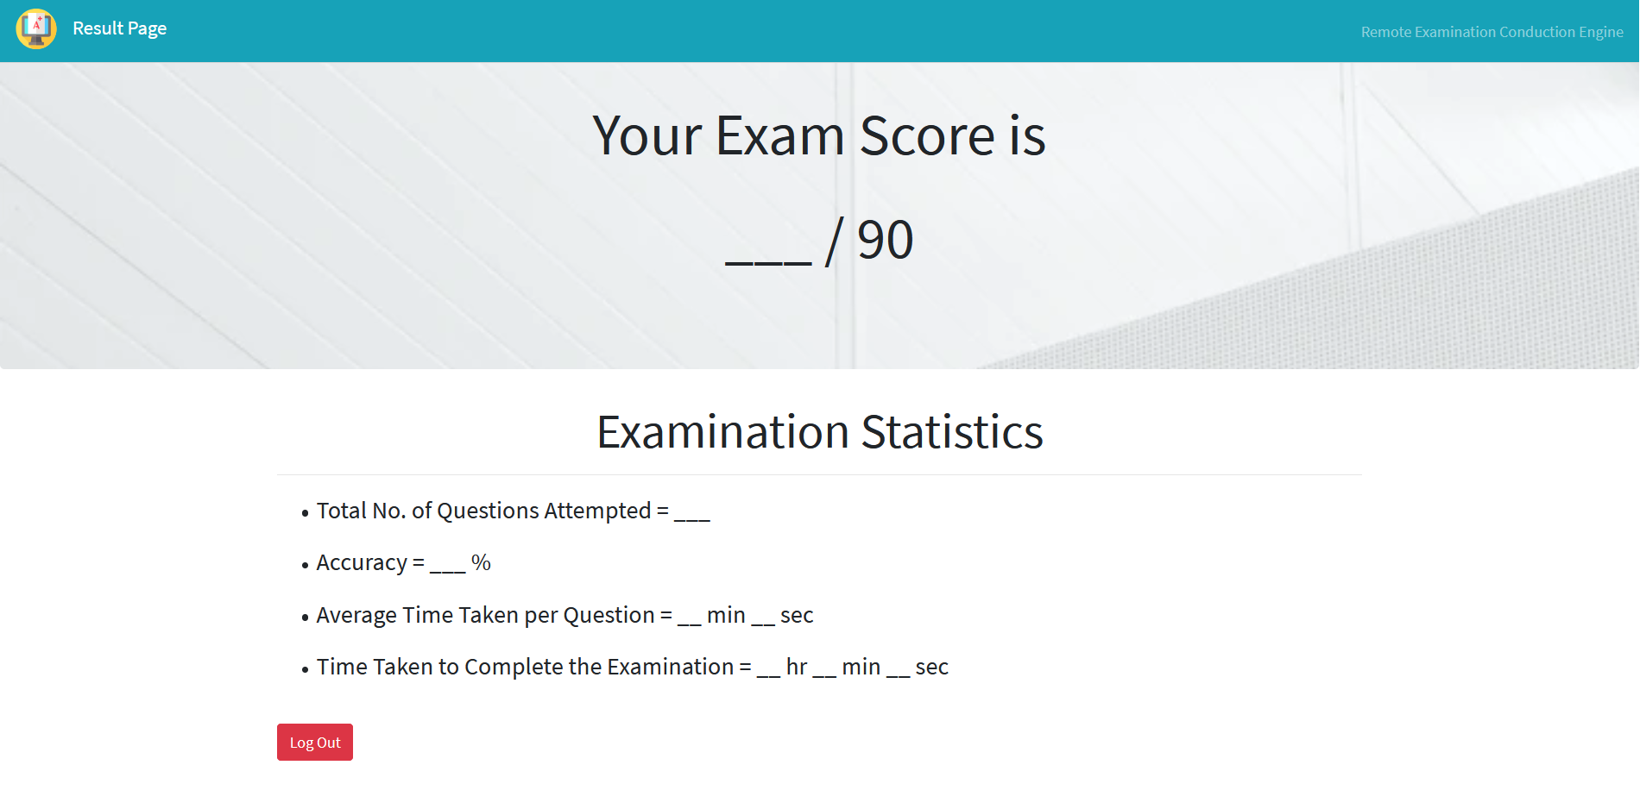
Result Page:

Slide 18
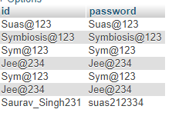
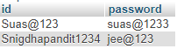
BACKEND:
1. Login Database: 2. Admin Database:

Slide 19
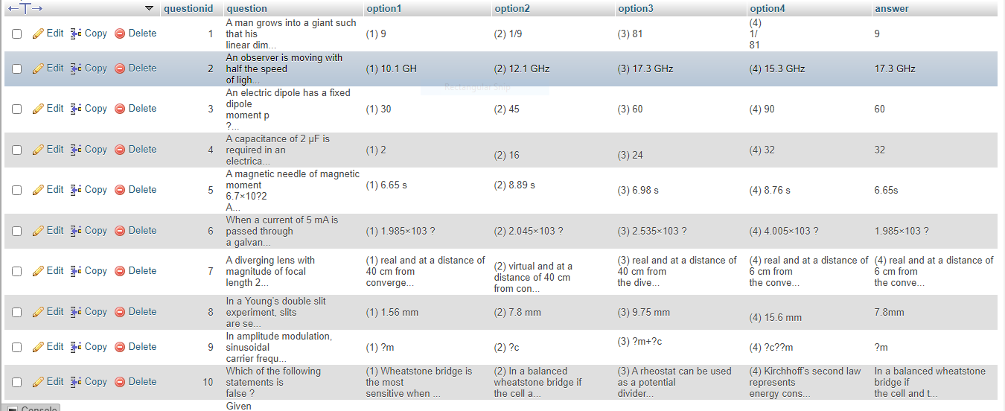
2. Question Database:

Slide 20
FEATURES WHICH CAN BE ADDED TO THIS PROJECT IN FUTURE
Speech to Text Recognition
Finger-print Scanner
Scan and upload answers
Speech synthesis
CBIR(Content based image retrieval is a technique use to match images)
By functional addition of above mentioned features, this project can be more likely used by the visually challenged people to attempt the online examination. By the use of this project, specific organizations can take visually challenged people into consideration of a job by conducting same online examination for normal as well as visually challenged people.

Slide 21
CONCLUSION
After observing the current examination system, the team aimed at designing a system which would help minimize the amount of paper and convert all forms of documentation to digital form. We aimed at providing the examinee ease and accuracy in the results in the computerized system. Even the examinee has minimum knowledge about computer they will easily be able to operate the system. The system also produces brief result required by the management.

Slide 22
THANK YOU

